Slide 1
Motion Capture with Arduino
CS 4392.001
Alex Johnston
awj150030

Slide 2
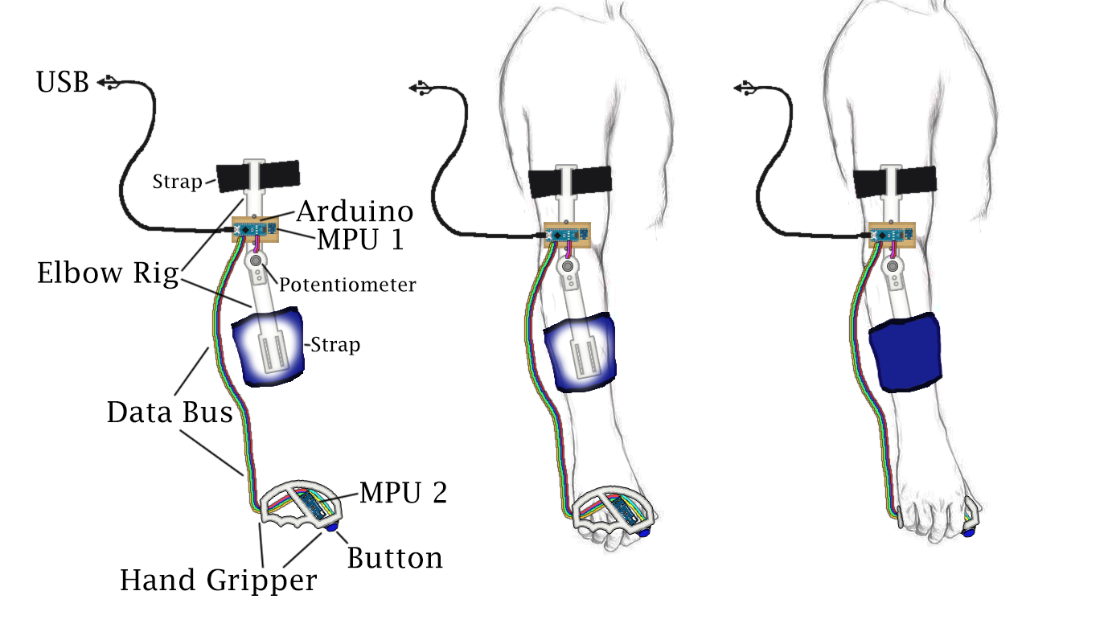
Physical Rig

Slide 3
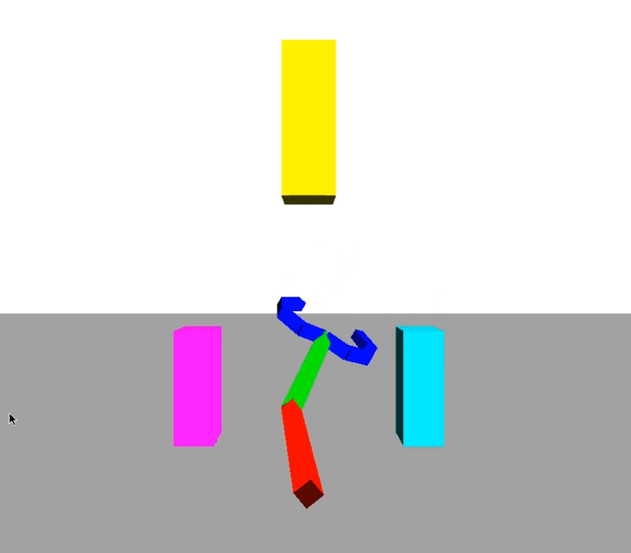
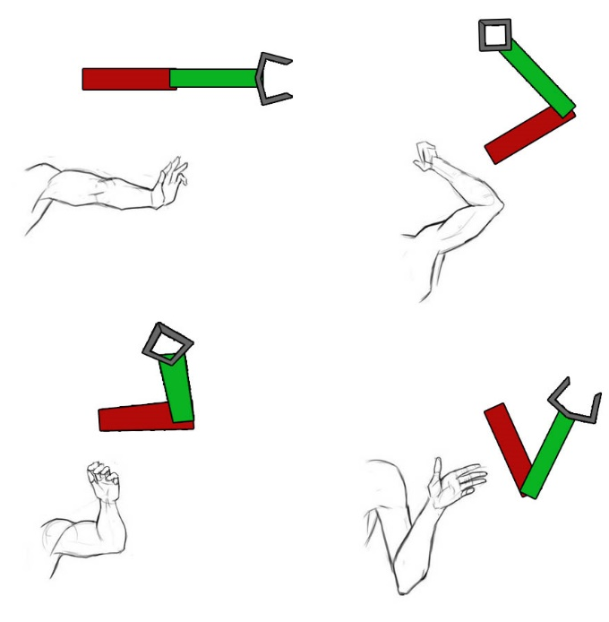
Demo Software

Slide 4
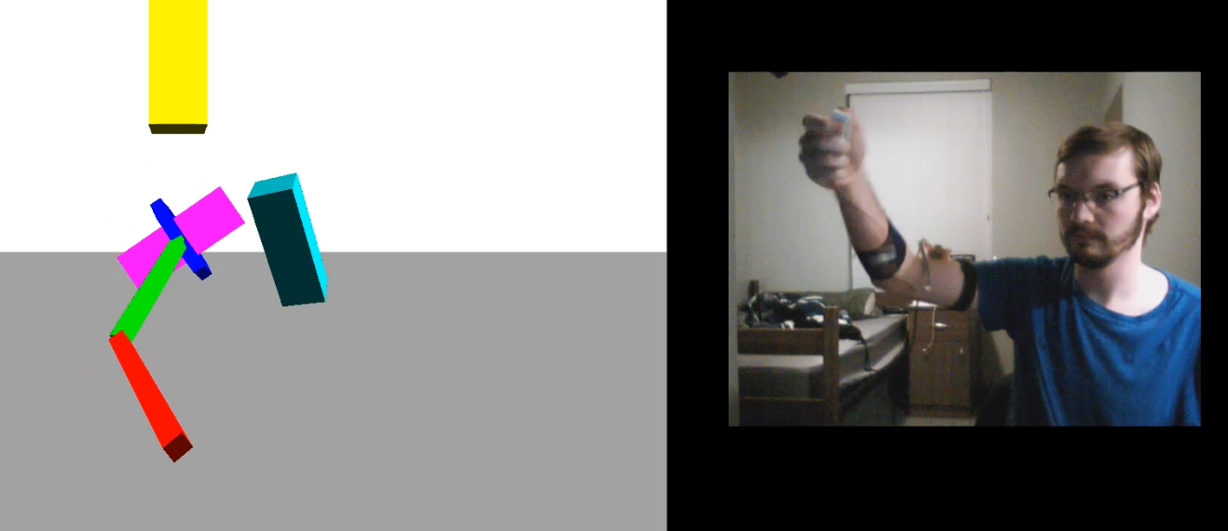
Demo Software

Slide 5
Challenges (too many)
Serial Communication Encoding
Rotational Drift
MPU6050 breaks I2C Standard
Quaternion Nonsense

